Slide 1
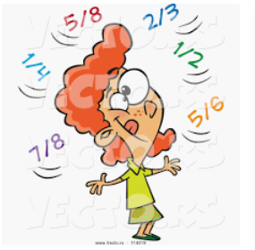
Math
Identifying decimal fractions with 10 and 100

Slide 2
Then I have posted 3 work book pages (668,674,680) for you to
do independently, and I will have the answers for them Monday
IF you get stuck on one today- DOjo me page # and Q # and
I will go over that question first.
Remember Zearn.org If you forgot your log in or password
then Dojo me.

Slide 3
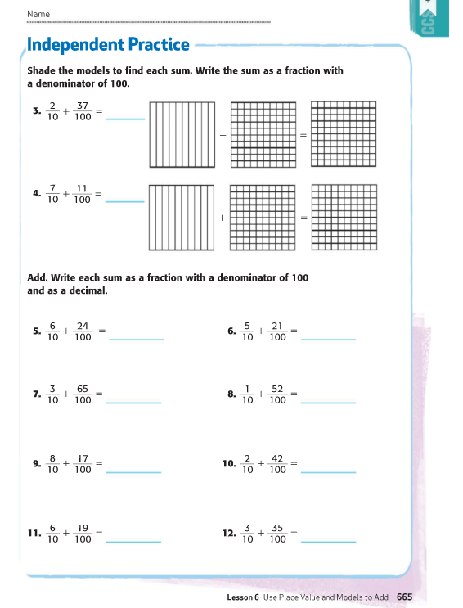
remember this will change
to 20
.57
100
70
.81
60
.84
.71
100
30
.95
.62
100
80
.97
.62
100
60
.79
.65
100

Slide 4
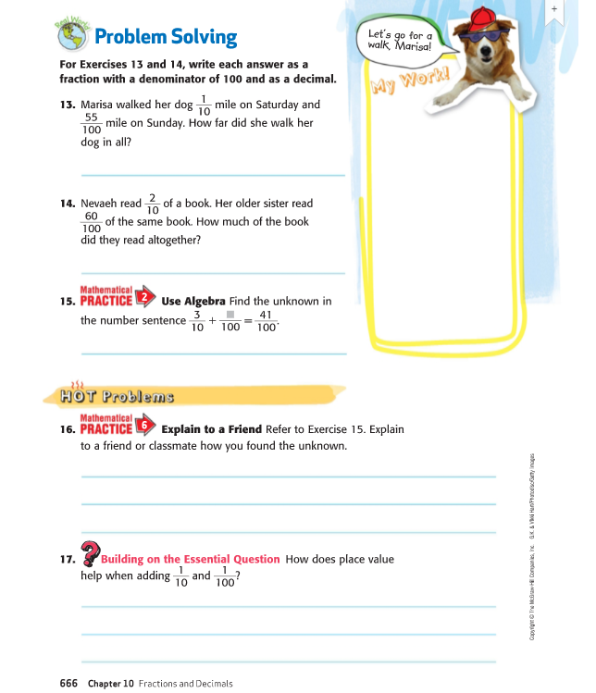
.65 mile
.80 of a book
41 - 30 = 11
.11
I subtracted what I knew 41 from 30 because
3/10 = 30/100
you can't add with unlike denominators. 1/10 is
really 10/100

Slide 5
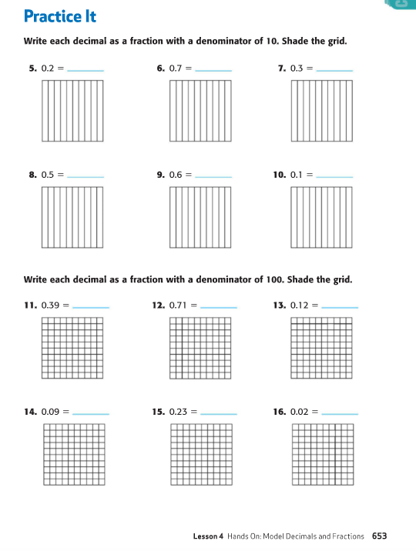
This will be easier to do if you have your workbook

Slide 6
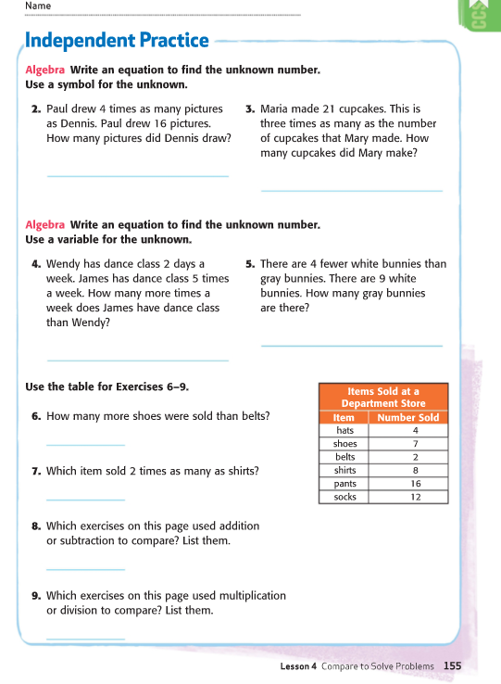
= 21
Mary made 7
because 7 x 3 = 21
16 x 4 = 64
Maria made more.
9
9 grey + 4 = 13
w w w
w w w
w w w
g g g
g g g
g g g
g g g g
5 - 2 = ?
answer 3
This diagram shows there are 9
fewer white bunnies than grey.
7 - 2 = 5
pants because 8 x 2 = 16
4,5,6
2,3,7

Slide 7
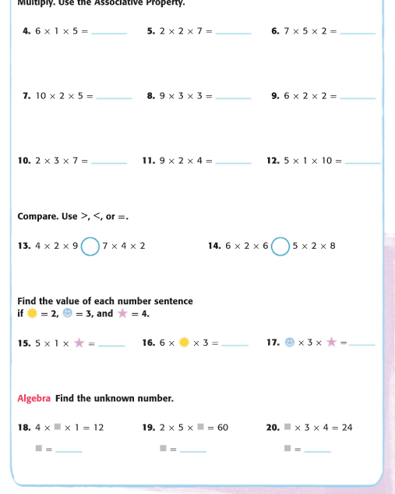
30
28
70
100
81
24
42
72
50
>
<
72
56
72
80
20
36
36
3
6
2

Slide 8
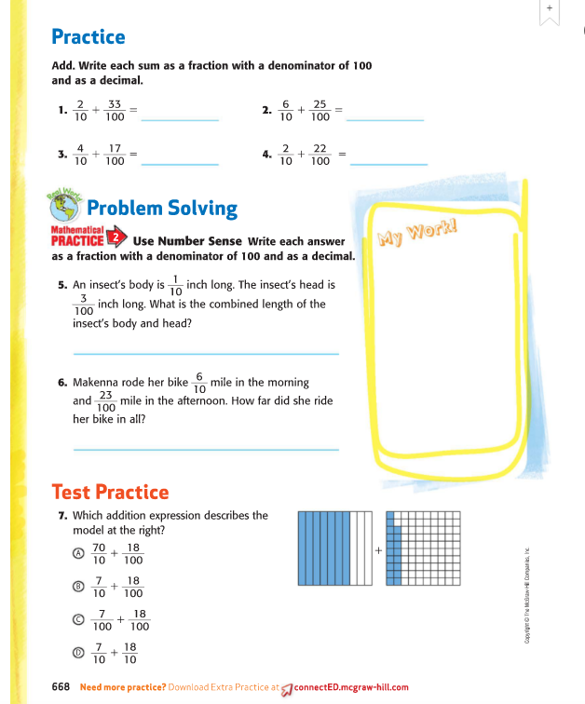

Slide 9
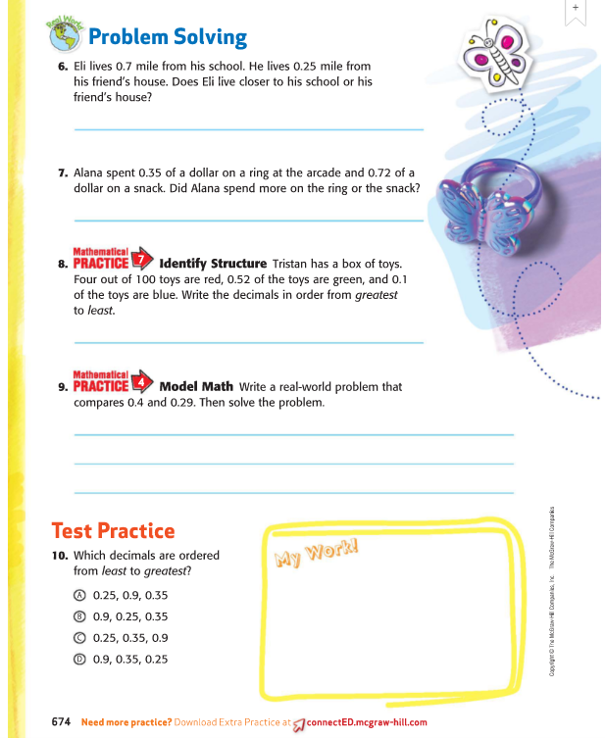

Slide 10
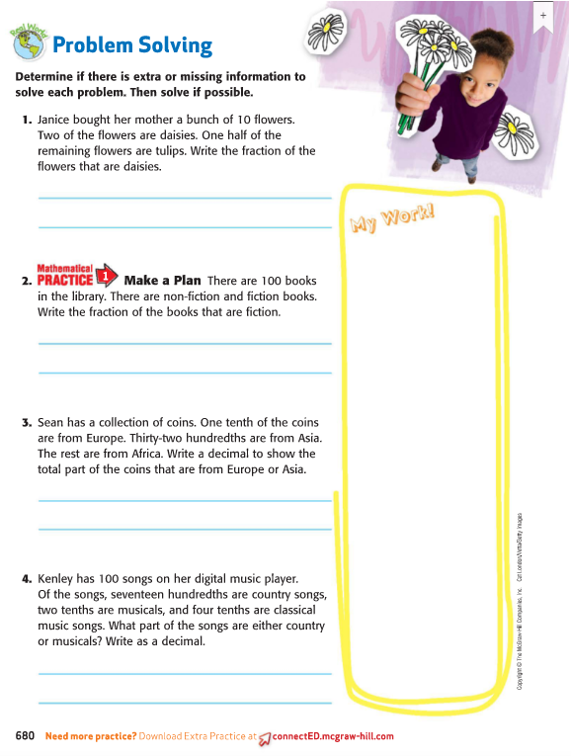

Slide 13
